Slide 1

CAPM and Fama French Model Under Covid-19 in US Market
Presented by Group 6

Slide 2

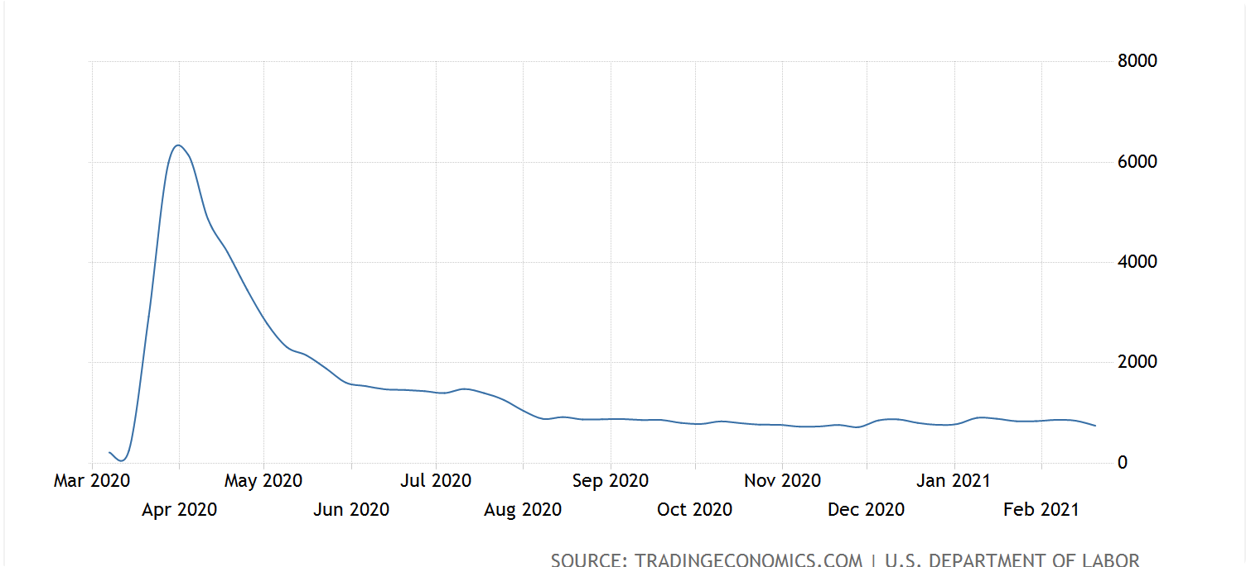

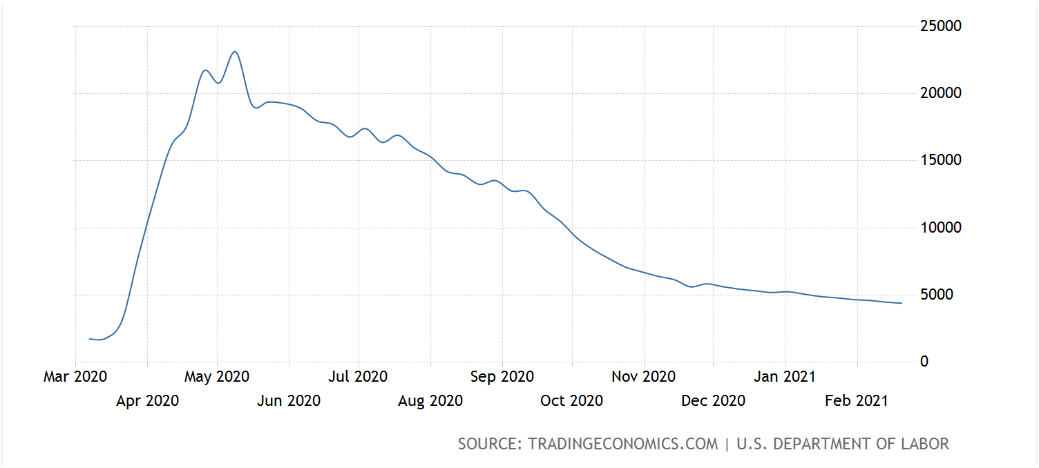
Introduction: Covid-19 outbreak
Daily Life
Unemployment
US initial and continuing jobless claims, Mar 2020 - Feb 2021
https://tradingeconomics.com/united-states/jobless-claims

Slide 3
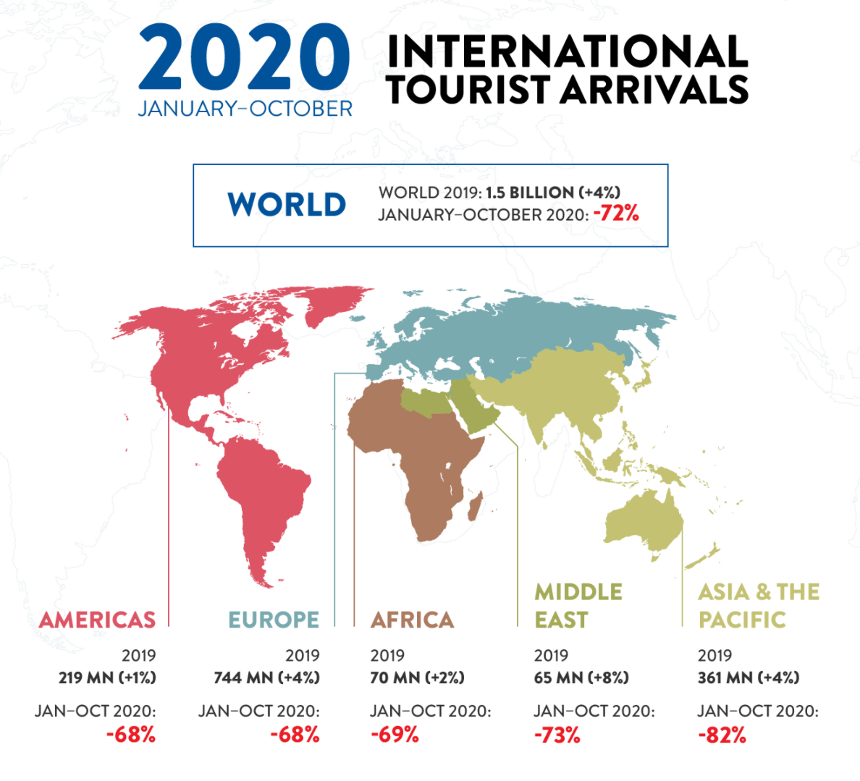
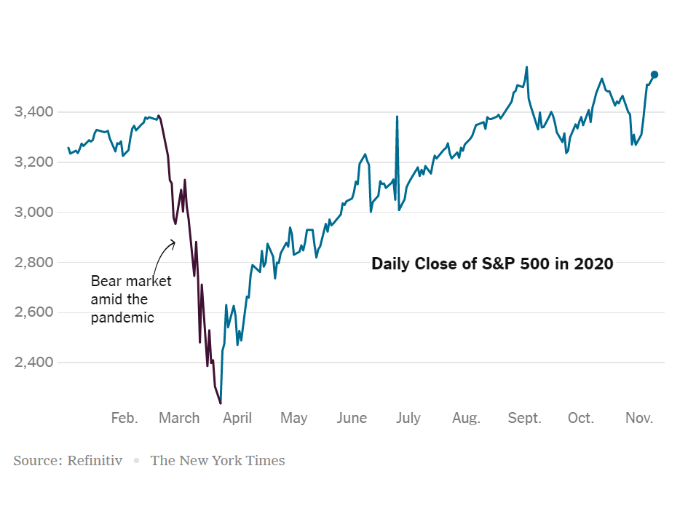
Introduction: Covid-19 outbreak
Tourism Industry
Financial Market
https://www.unwto.org/impact-assessment-of-the-covid-19-outbreak-on-international-tourism

Slide 4
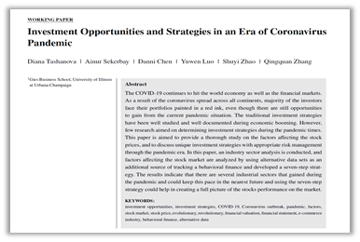
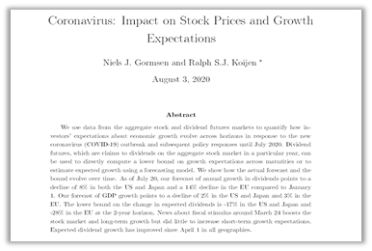
Introduction: Covid-19 outbreak
Gormsen and Koijen(2020)
Tashanova(2020)
Is CAPM and Fama French model efficient for analyzing stock prices under Covid-19?

Slide 5
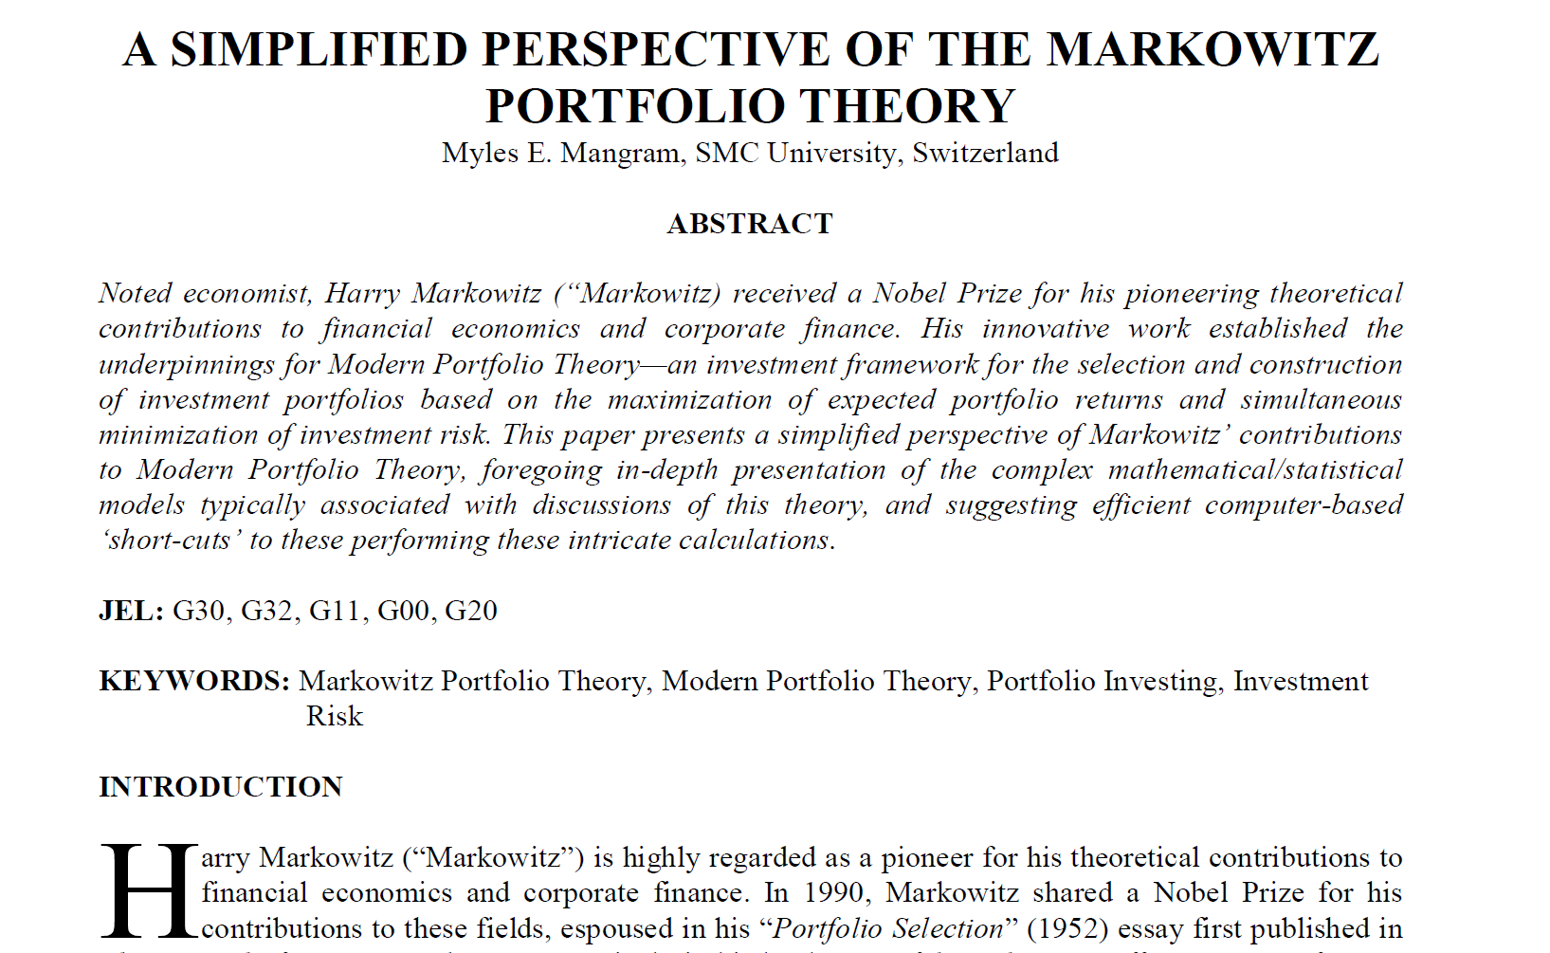
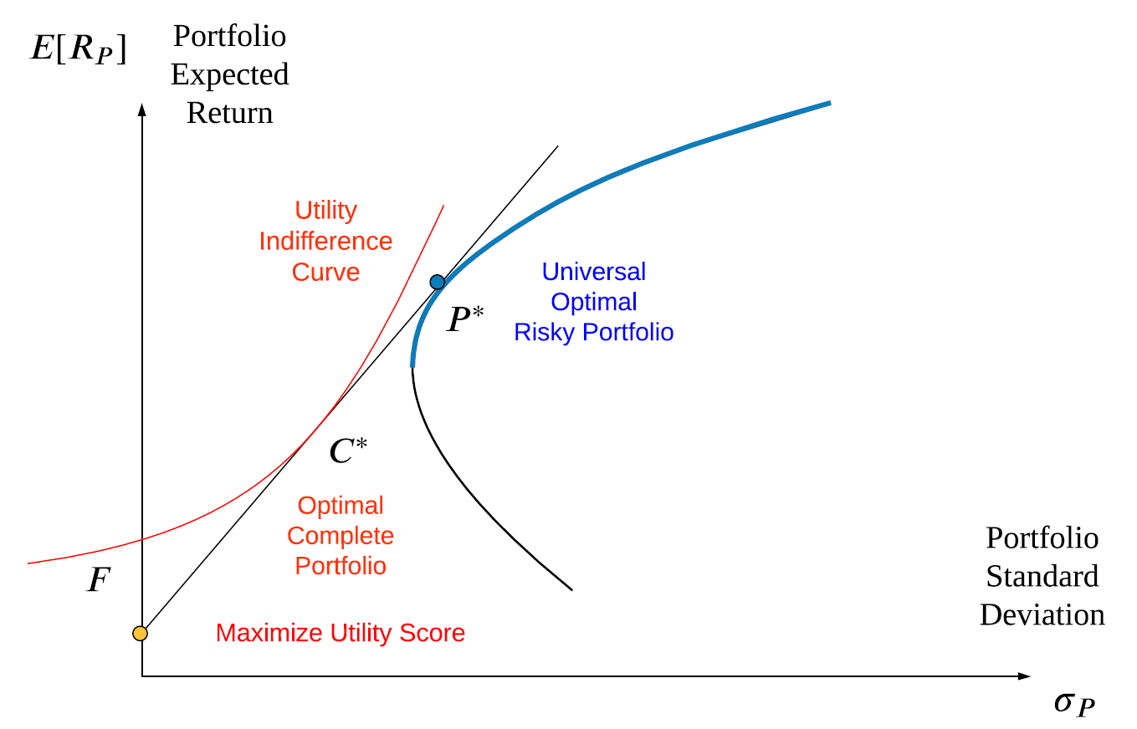
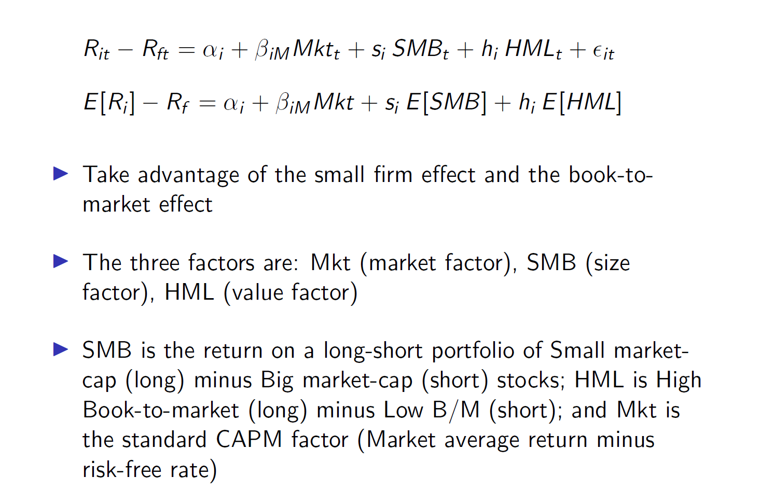
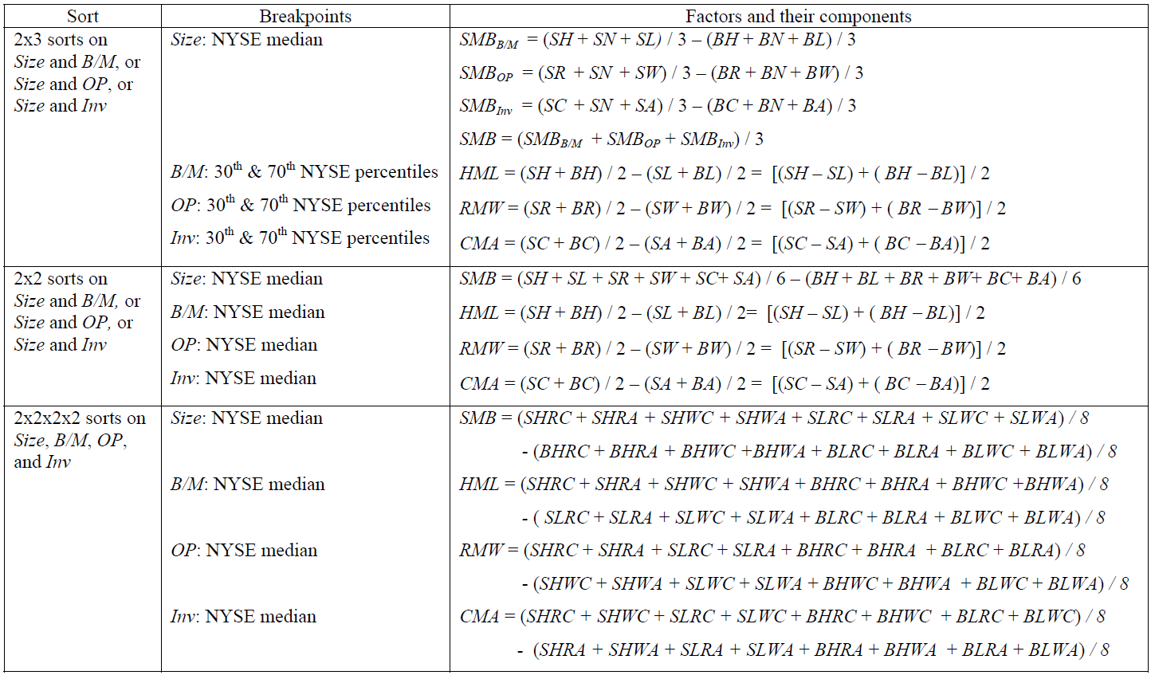
Literature Review: To Forecast the Future Price Trend
Mean-variance Model
Capital Asset Pricing Model
How they
Work in
Covid-19?
Fama French Three Factor Model
Fama French Five Factor model

Slide 6
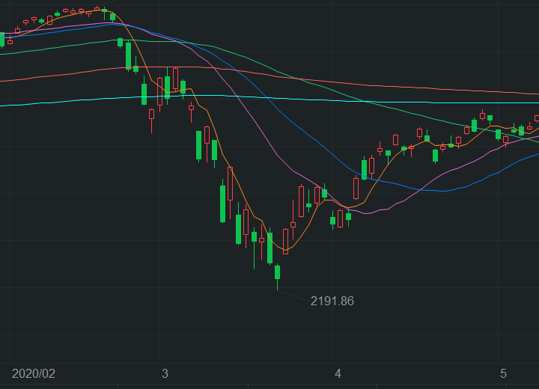
Experiment: CAPM Analysis
2-Set Analysis
CAPM Calculation
access daily stock price
calculate daily return
calculate excess return
time series regression
OLS regression
Mar
Apr

Slide 7
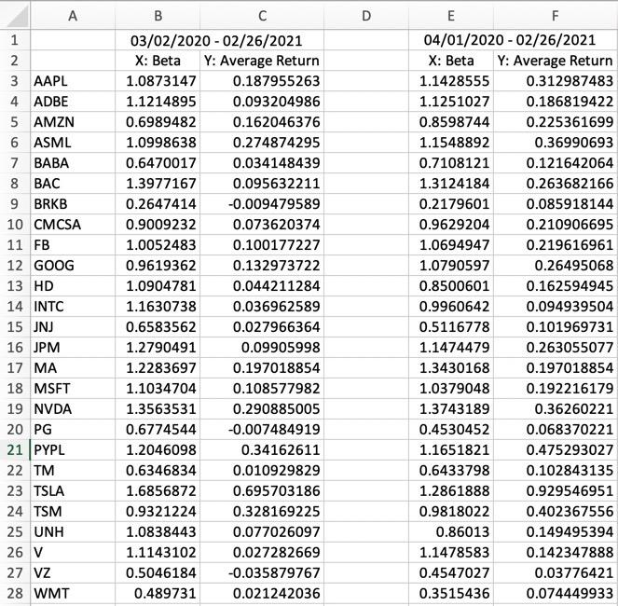
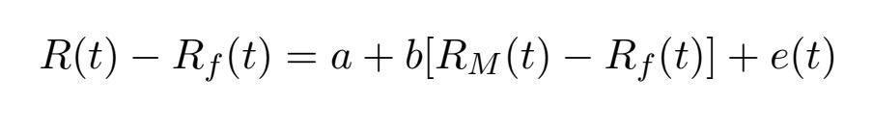
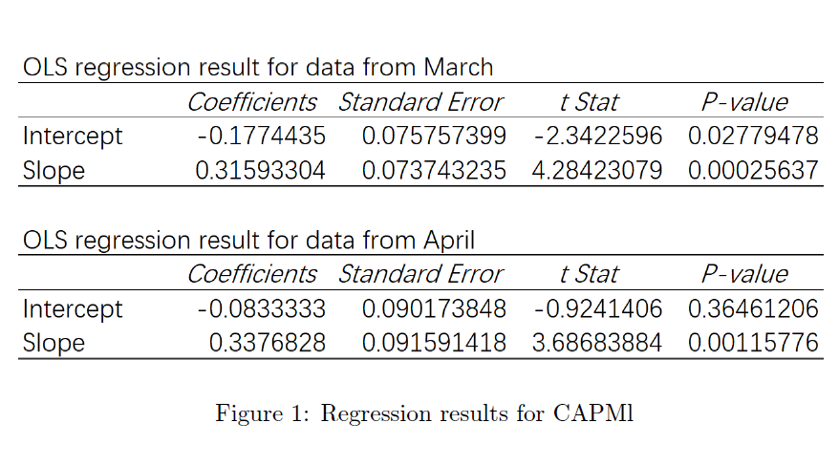
Experiment: CAPM Analysis and Result
CAPM Analysis
CAPM Result

Slide 8
Experiment: List Forming and Data Description
List Forming
Data Description
Market Capitalization
Size
Net assets per share/stock price
Book to Market Ratio
Whole Market
S&P
500
80%
Total asset YoY change%
Investment
top 50 companies
Top 10 26%
Net income/net asset value
As of March 31, 2020, source: https://www.investopedia.com/top-10-s-and-p-500-stocks-by-index-weight-4843111
Profit

Slide 9
Experiment: Fama French Model Analysis
Grouping
Analysis
30%
40%
30%
Small B/M
Mid B/M
Large B/M
Market Value
Small Size
Book to Market Ratio
Mid Size
Investment
Profit
Large Size

Slide 10
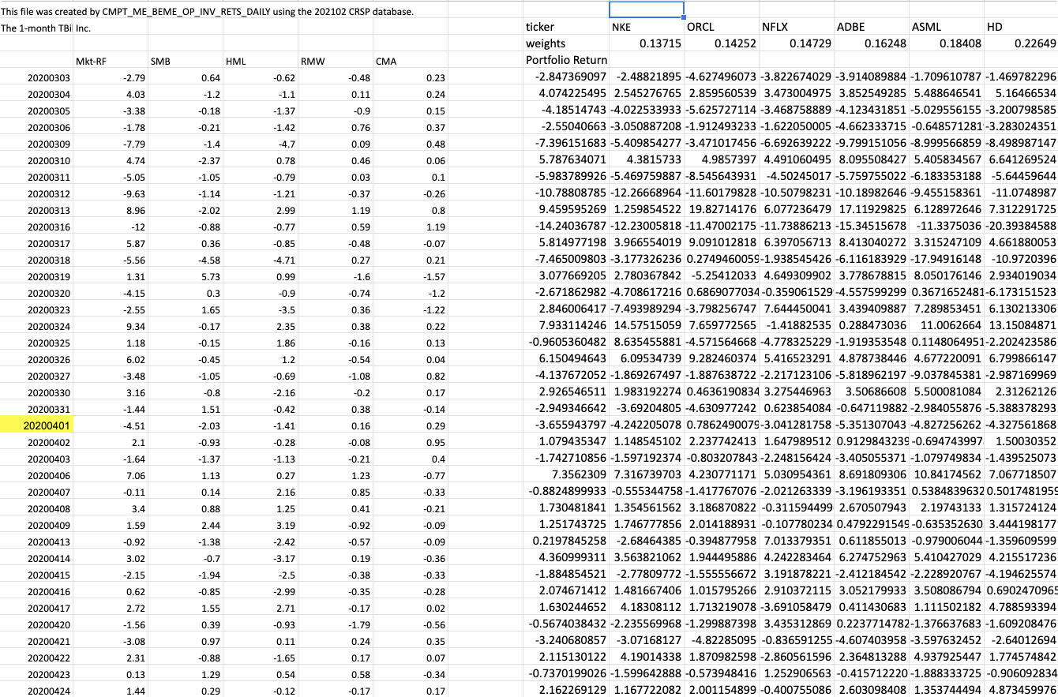
Experiment: Fama French Model Analysis
Grouping & Fama French Model Regression
Grouping with python
Constructing Portfolios
Time Series Regression

Slide 11
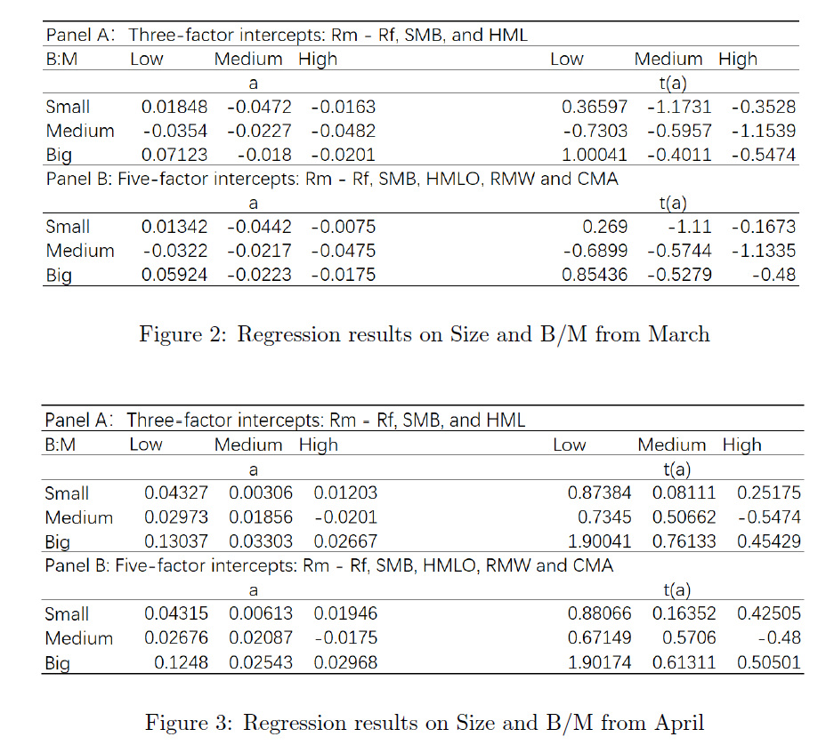
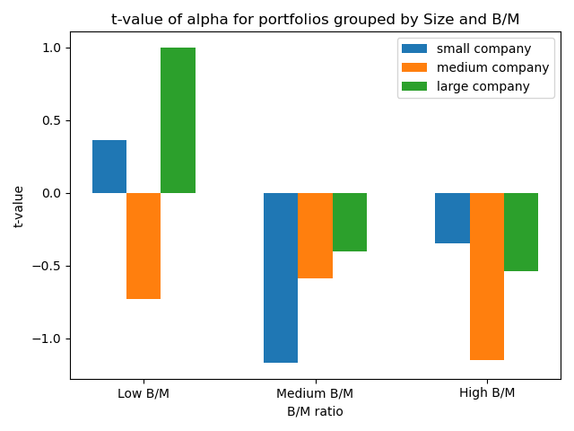
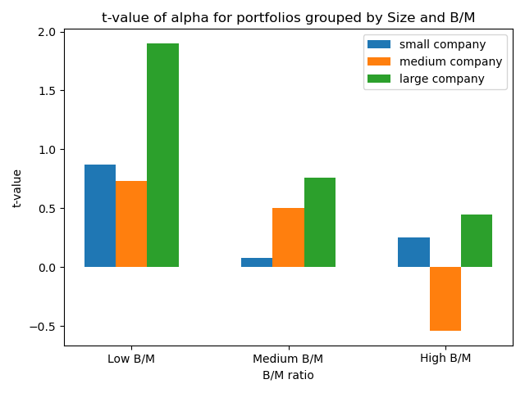
Fama French Result --By YU Yiduo
Fama French Result (Size & B:M)
Bar charts

Slide 12
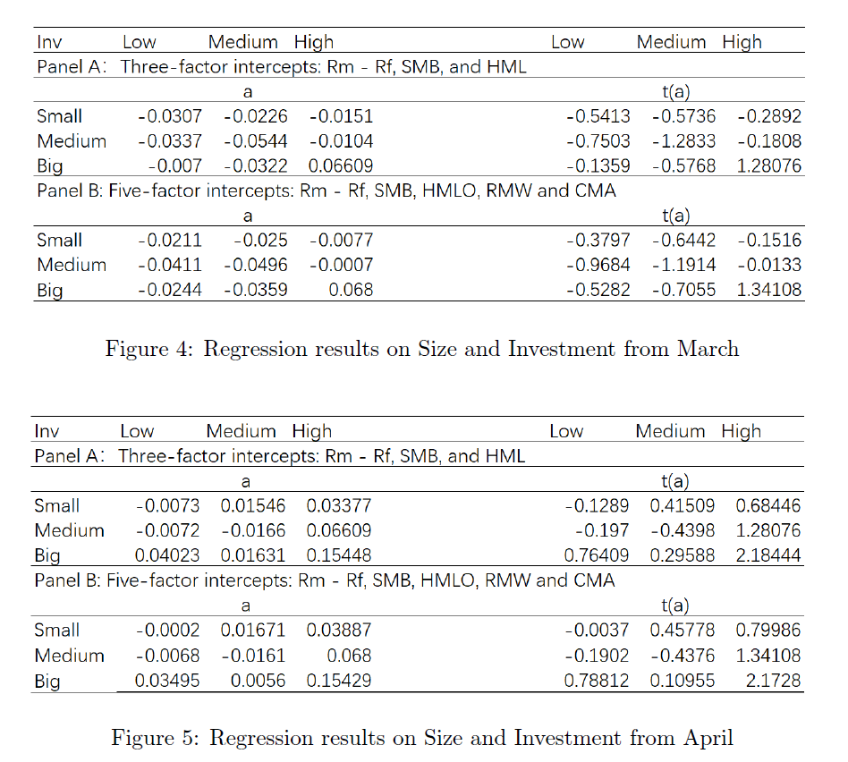
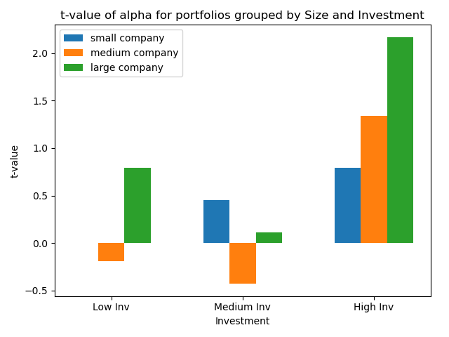
Fama French Result
Fama French Result (Size & Inv)
Bar chart

Slide 13
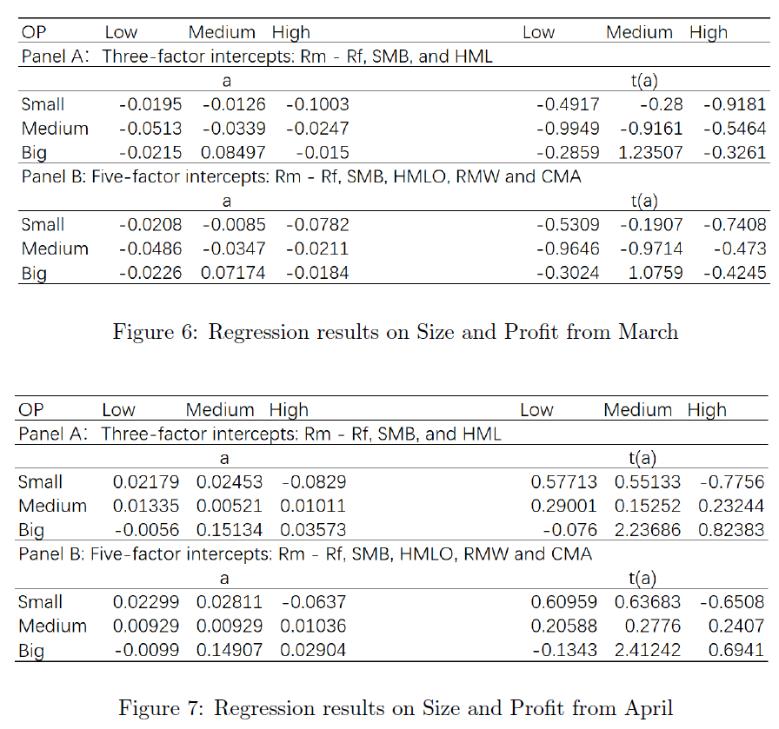
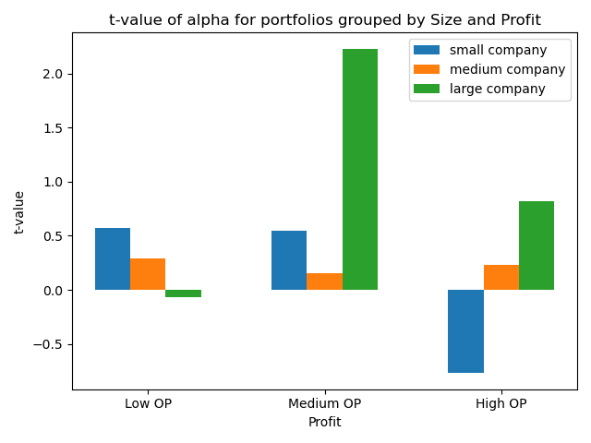
Fama French Result
Fama French Result (Size & OP)
Bar chart

Slide 14
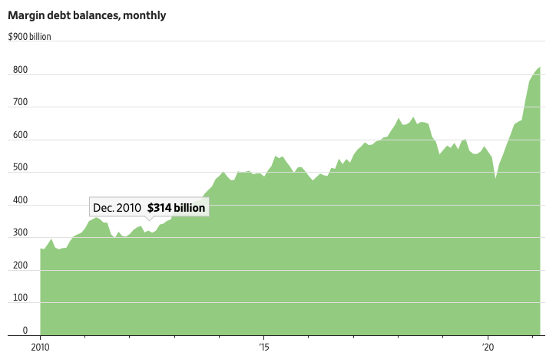
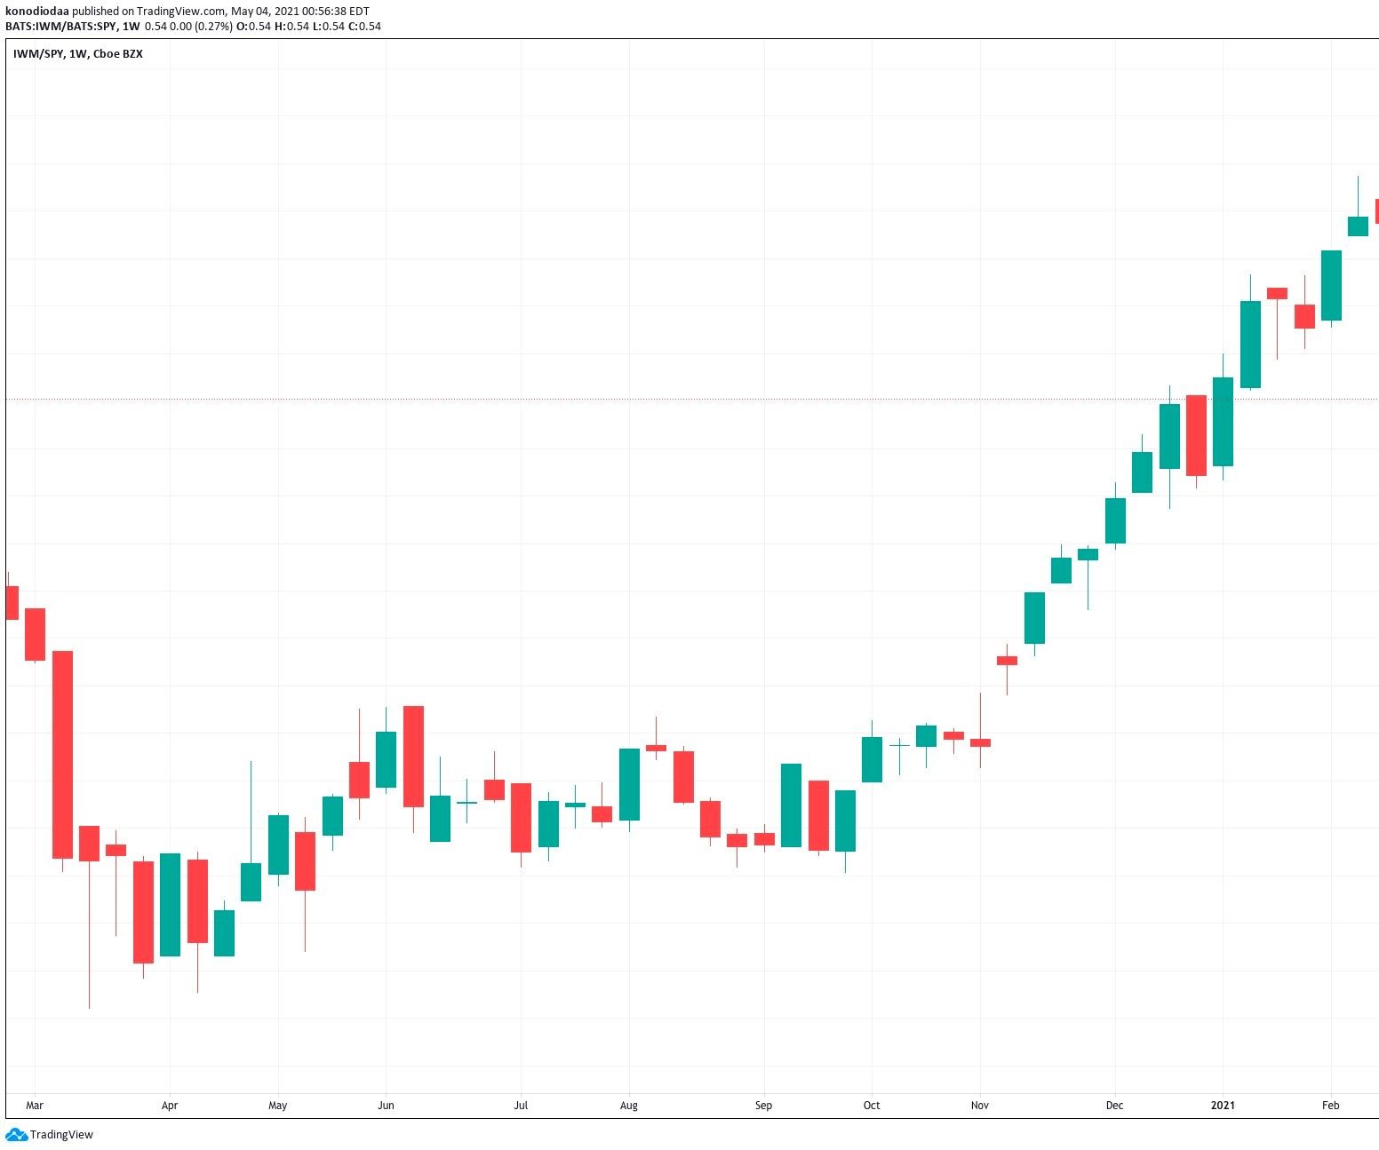
Proposed Explanation For Abnormal Data
Margin debt balance
IWM/SPY
Figures as of March, Source: Finra
Figures from Mar 2020 - Feb 2021, Source: Tradingview, Cboe

Slide 15
Conclusion
CAPM is generally good during bull market
CAPM fails to explain the case in recession
Three factor model and five factor model are all suitable pricing models
No substantial difference found among them
Three factor model is already good enough

Slide 16
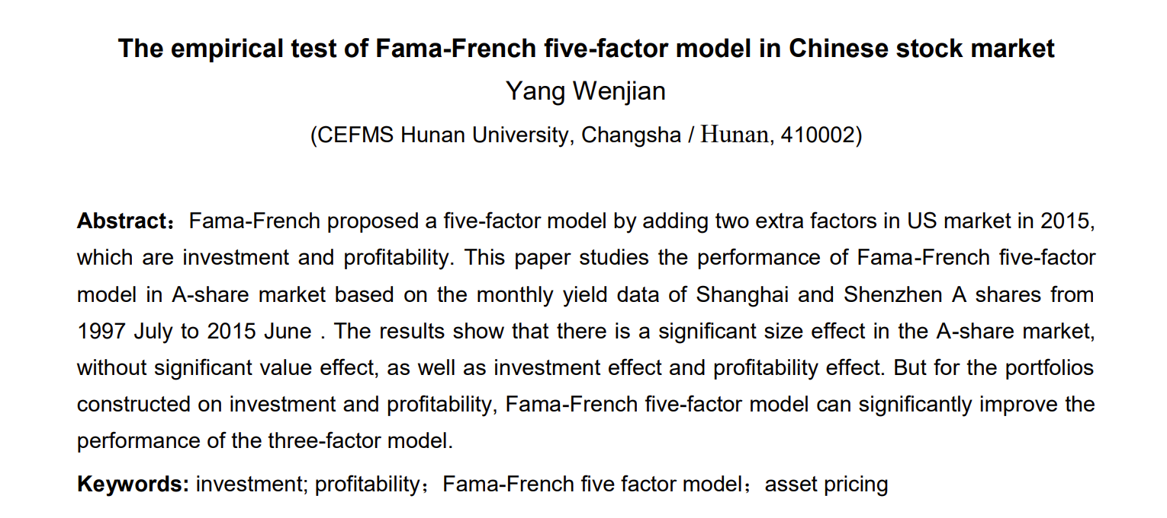
Acknowledgements
The Empirical Test of Fama-French Five-Factor Model in Chinese Stock Market
--Wenjian Yang

Slide 17
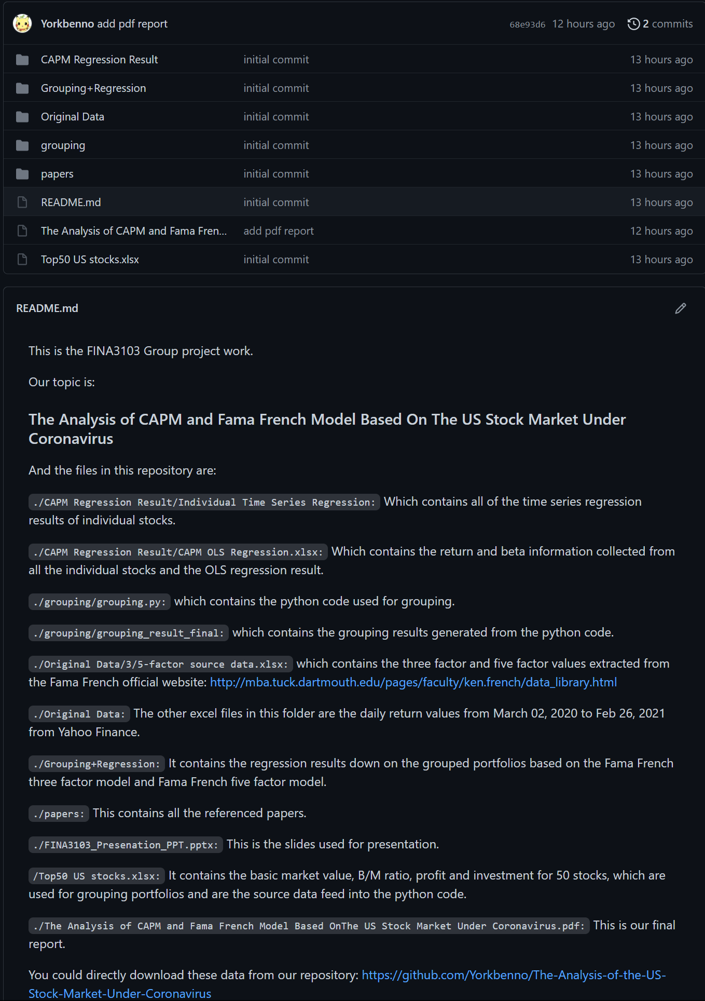
Github Repository
https://github.com/Yorkbenno/The-Analysis-of-the-US-Stock-Market-Under-Coronavirus
Original excel files
Regression results
Referenced papers
Our final report
Python code

Slide 18
References
Fama, Eugene F. and Kenneth R. French. Common Risk Factors in the Returns on Stocks and Bonds. Journal of Financial Economics. (1993)
Fama, Eugene F. and French, Kenneth R., The Capital Asset Pricing Model: Theory and Evidence. Journal of Economic Perspectives (August 2003)
Fama, E.F. and French,K.R. A five-factor asset pricing model. Journal of Financial Economics. (2015)
Gormsen, Niels Joachim and Koijen, Ralph S. J., Coronavirus: Impact on Stock Prices and Growth Expectations, University of Chicago, Becker Friedman Institute for Economics Working Paper (August 3, 2020)
Lintner, John. The Valuation of Risk Assets and the Selection of Risky Investments in Stock Portfolios and Capital Budgets. Review of Economics and Statistics, (1965)
Markowitz, H. M. Portfolio Selection, Journal of Finance, (1952)
Novy-Marx, R. The other side of value: The gross profitability premium. Journal of Financial Economics (2013)
Sharpe, William F. Capital Asset Prices: A Theory of Market Equilibrium under Conditions of Risk”, Journal of Finance. (1964)
Titman, S., Wei, K., Xie, F. Capital investments and stock returns. Journal of Financial and Quantitative Analysis (2004)
Tashanova, Diana and Sekerbay, Ainur and Chen, Danni and Luo, Yuwen and Zhao, Shuyi and Zhang, Qingquan, Investment Opportunities and Strategies in an Era of Coronavirus Pandemic, Working Paper (April 2, 2020)
Wenjian Yang. The empirical test of Fama-French five-factor model in Chinese stock market. University Humanities and Social Sciences Information Network of China. (2017)

